Slide 1



Capstone Project Phase B - 61999
Citation Prediction using GAN
Biran Fridman
Ilya Lev
Supervisors:
Dr. Renata Avros
Prof. Zeev Volkovich

Slide 2

01
The Need For An Automated system
The Problem:
Academic integrity is compromised by irrelevant citations, cluttering scholarly work with irelevant information.
Manually going through each cited article for relevance is labor-intensive, error-prone, and impractical given the vast body of literature.
The Need For Automation:
There is a pressing need for an automated system capable of efficiently evaluating citation relevance.
Such a system would not only preserve the integrity and quality of scholarly articles but also streamline the research process by assisting in the identification of truly pertinent literature.
The Effects:
Irrelevant citations can mislead research direction, inflate the perceived impact of articles, and dilute the quality of academic discourse.
The sheer volume of research publications emerging every day poses an impossible challenge, making manual vetting unsustainable.
Notes:
הצגה קצרה של הרקע: הבעיה, הצורך לפיתוח המערכת

Slide 3
02
The Main Requirements Of The System
Accuracy:
Must reliably differentiate between relevant and irrelevant citations, minimizing false positives and negatives.
Scalability:
Capable of handling the ever-growing volume of research articles and citations without a drop in performance.
Speed:
Fast processing times to provide real-time or near-real-time evaluations, facilitating efficient research workflows.
Correctness:
Ensures the system’s outputs are accurate and reliable, reflecting true scholarly connections and citation relevancy.
Notes:
הדרישות המרכזיות של המערכת

Slide 4
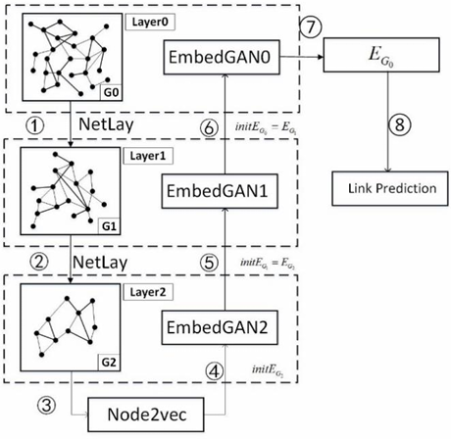
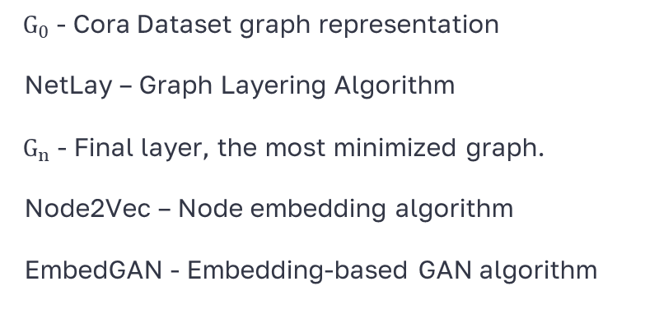
Our Solution - GAHNRL
03
High-Level Architecture Diagram
${ G}_{0}$ - Cora Dataset graph representation
NetLay – Graph Layering Algorithm
${ G}_{n}$ - Final layer, the most minimized graph.
Node2Vec – Node embedding algorithm
EmbedGAN - Embedding-based GAN algorithm
Notes:
הצגה קצרה של הרקע: הבעיה, הצורך לפיתוח המערכת

Slide 5
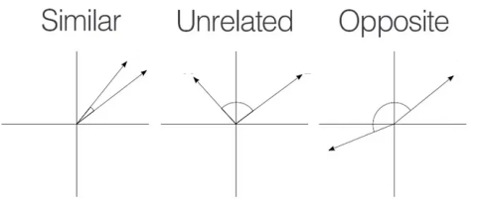

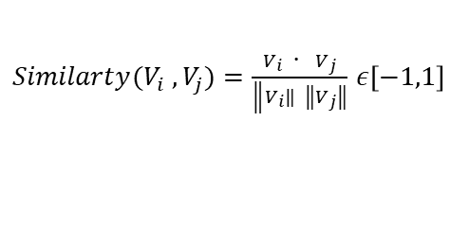
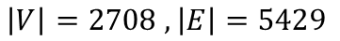
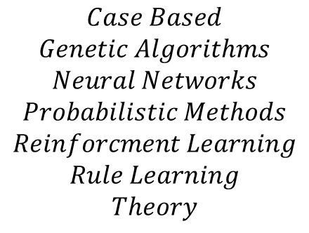
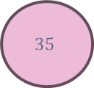
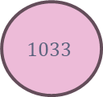
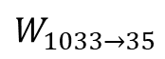
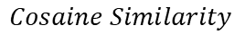
04
Graph Construction and Edge Weight Calculation
$$V_{35}=\left[0,1,0,1,1…….,0\right]∈R^{1433}$$
$$V_{1033}=\left[1,1,0,0,1…….,1\right]∈R^{1433}$$
$$1033$$
$$W_{1033→35}$$
$$35$$
$$Cosaine Similarity$$
$$\left|V\right|=2708 , \left|E\right|=5429$$
$$Case Based$$
$$Genetic Algorithms$$
$$Neural Networks$$
$$Probabilistic Methods$$
$$Reinforcment Learning$$
$$Rule Learning$$
$$Theory$$
$Similarty(V_{i} ,V_{j})=\frac{V_{i} \text{⋅} V_{j}}{\left\|\left.V_{i}\right\| \left\|\left.V_{j}\right\|\right.\right.}$ $ε\left[−1,1\right]$
$$W_{1033→35}=\frac{Similarty\left(V_{1033} ,V_{35}\right)+1}{2}ε\left[0,1\right]$$

Slide 6
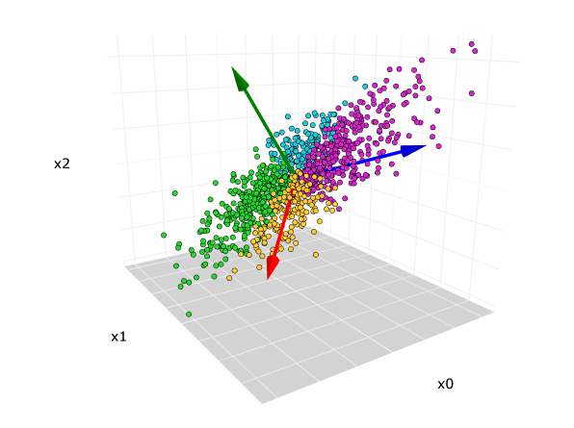
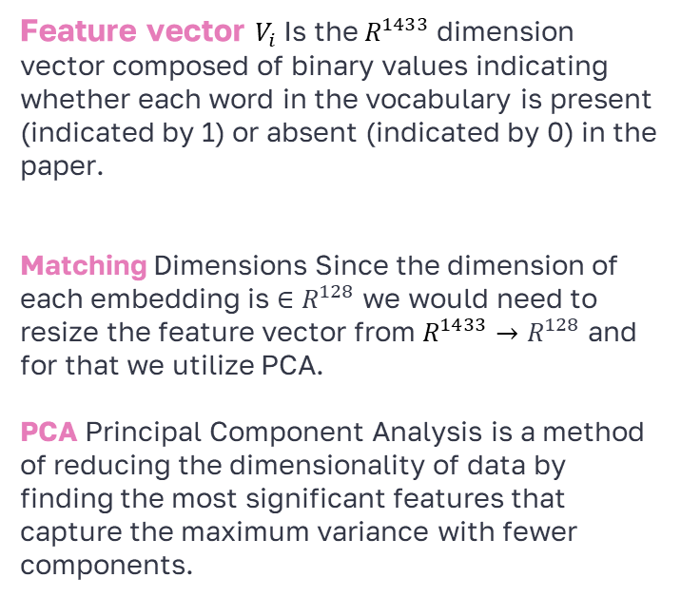
05
Principal Component Analysis
Feature vector $V_{i}$Is the$R^{1433}$ dimension vector composed of binary values indicating whether each word in the vocabulary is present (indicated by 1) or absent (indicated by 0) in the paper.
Matching Dimensions Since the dimension of each embedding is $∈R^{128}$ we would need to resize the feature vector from $R^{1433}→R^{128}$ and for that we utilize PCA.
PCA Principal Component Analysis is a method of reducing the dimensionality of data by finding the most significant features that capture the maximum variance with fewer components.

Slide 7
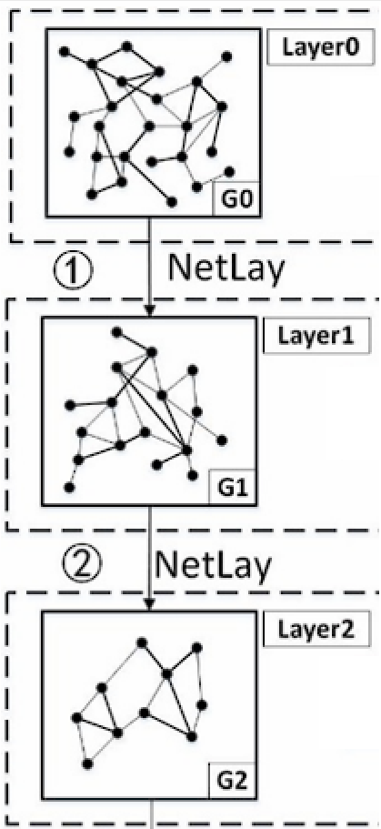
06
Lev - Fridman Netlay
Graph Network layering algorithm
Reduces Complexity
Less nodes and edges in each layer while preserving the essential structure.
Shows Hidden Patterns
Reveals underlying graph patterns and properties at each level.
Focuses on Key Citations
Highlights the most important and significant links.
Gives Layered View
Provides a multi-scale perspective of the network, with each layer offering different insights.
Notes:
הצגה קצרה של הרקע: הבעיה, הצורך לפיתוח המערכת

Slide 8
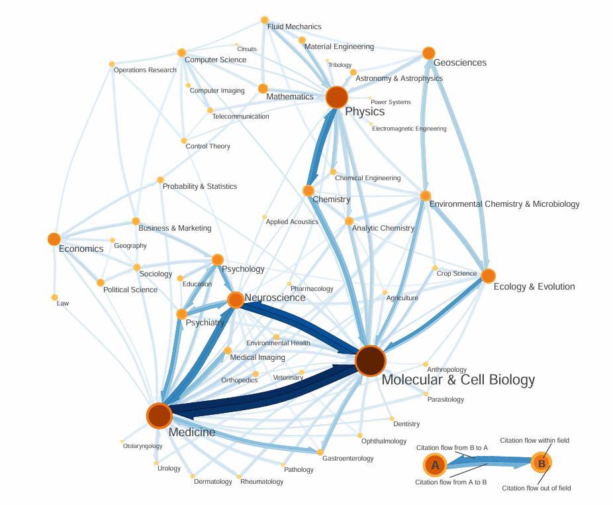
07
Lev - Fridman Netlay
Community Detection
Cluster Formation:
Detects and groups together articles that share a significant number of citations, signifying interconnected research themes.
Uses Community Infomap:
Uses Maps of random walks on complex networks reveal community structure by M. Rosvall and C. T. Bergstrom, known for effectively mapping complex networks, to outline the community structures that emerge from citation patterns.
Notes:
הצגה קצרה של הרקע: הבעיה, הצורך לפיתוח המערכת

Slide 9
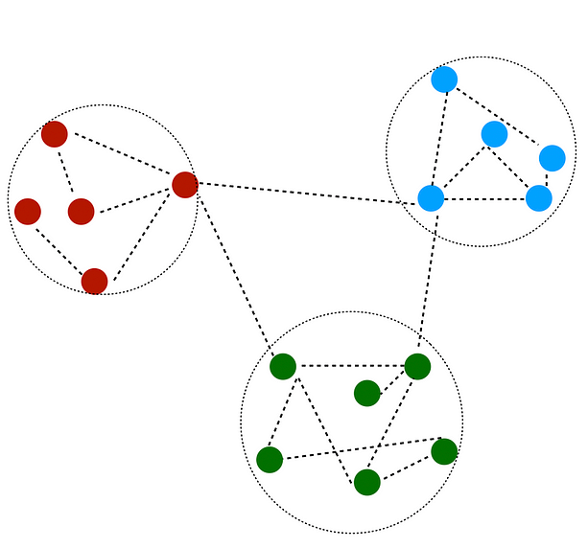
08
Lev - Fridman Netlay
Graph Coarsening
B
Merging Nodes: Nodes within the same community are merged into a super-node.
Creating new Edges: New edges between super nodes are added, when there is an edge connecting nodes of the respective communities in the original graph.
Edge Weights: The weight of the new edge is the average of aggregated weight of all edges connecting nodes from source cluster to nodes in the destination cluster.
Normalizing Edge Weights: normalization of edge weights in the newly simplified graph to a uniform range.
A
C
Notes:
הצגה קצרה של הרקע: הבעיה, הצורך לפיתוח המערכת

Slide 10
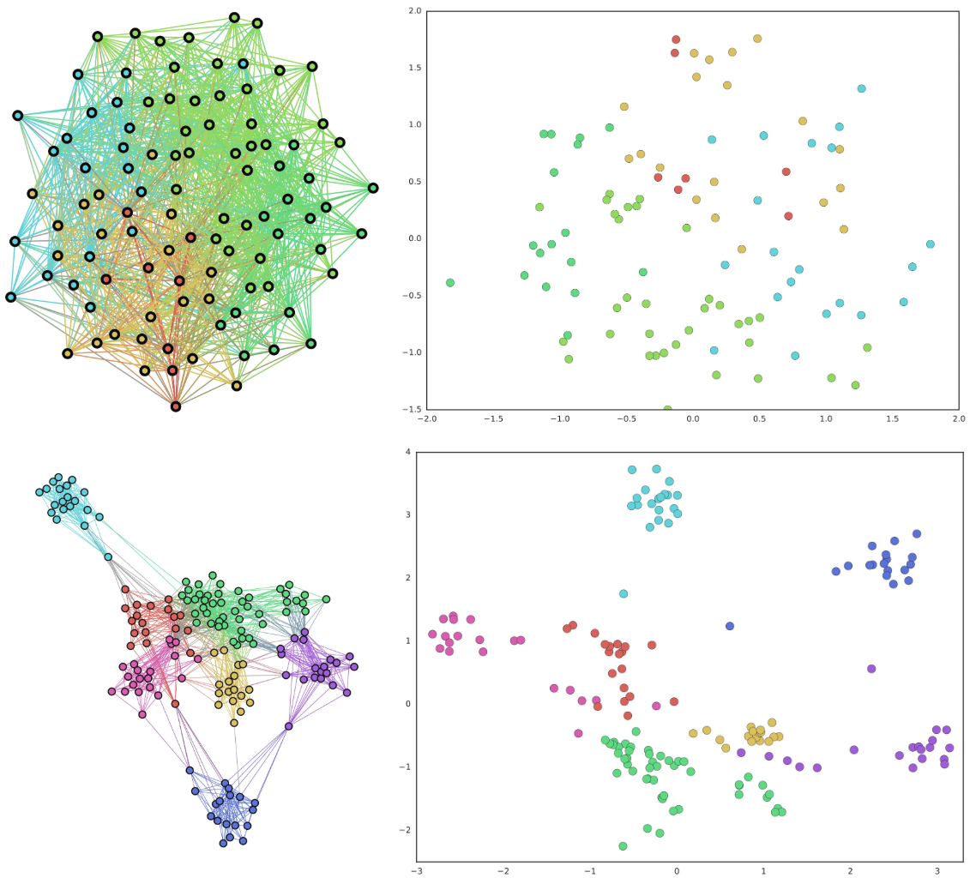
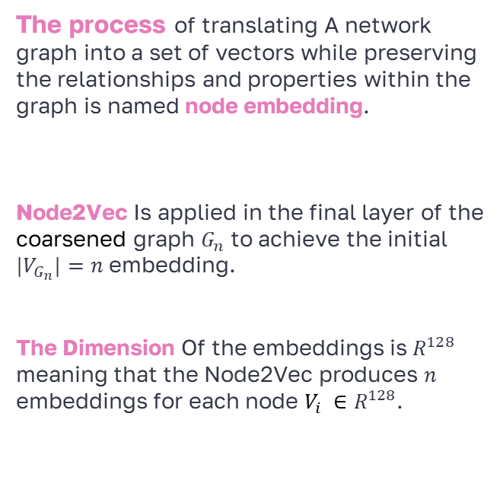
09
Node Embedding
The process of translating A network graph into a set of vectors while preserving the relationships and properties within the graph is named node embedding.
Node2Vec Is applied in the final layer of the coarsened graph $G_{n}$ to achieve the initial $|V_{G_{n}}|=n$ embedding.
The Dimension Of the embeddings is $R^{128}$ meaning that the Node2Vec produces $n$ embeddings for each node $V_{i} ∈R^{128}$.

Slide 11
10
Pre – Training Phase
Why Pre-Train?
Initializes models to improve learning efficiency.
Enhances the effectiveness of the full training process.
Pre-train Generator:
Start: Begin with random noise.
Goal: Train to produce embeddings similar to the most simple graph layer edges obtained from Node2Vec.
Pre-train Discriminator:
Inputs: Fake embeddings from the generator and real embeddings.
Objective: Train to distinguish between real and fake embeddings
Notes:
הצגה קצרה של הרקע: הבעיה, הצורך לפיתוח המערכת

Slide 12
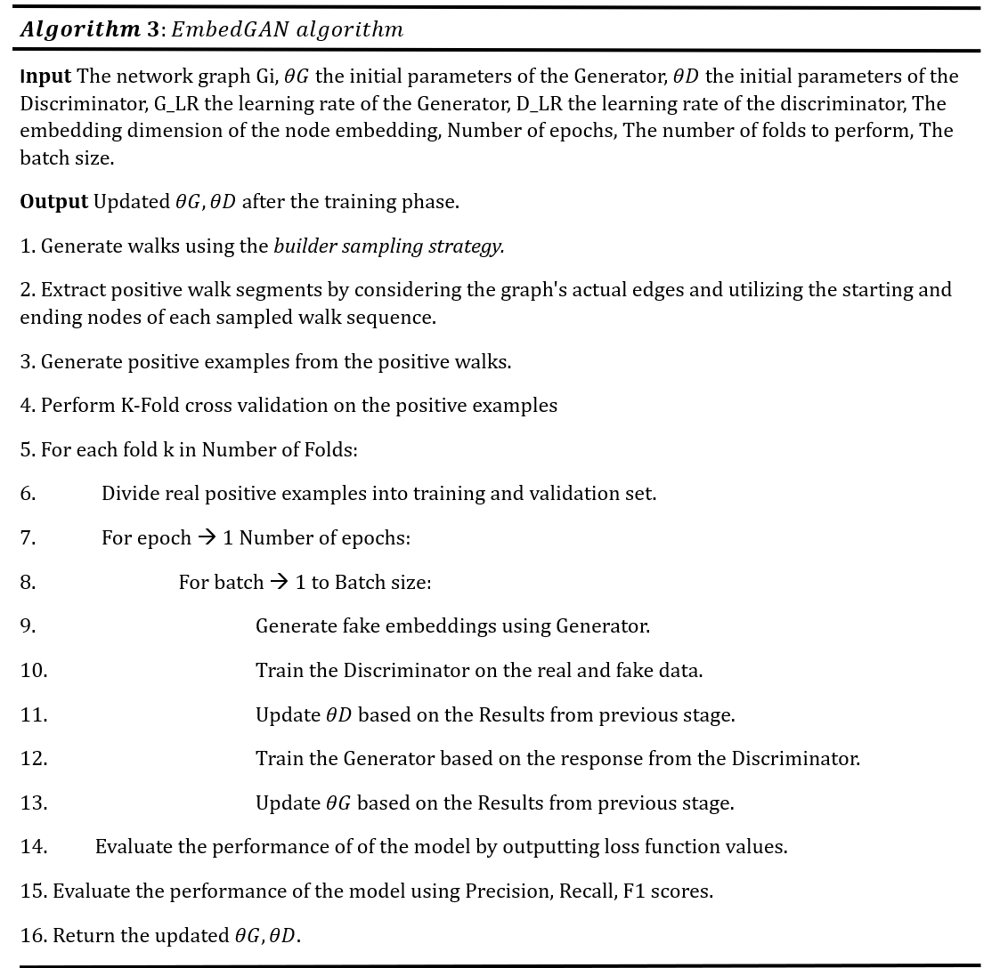
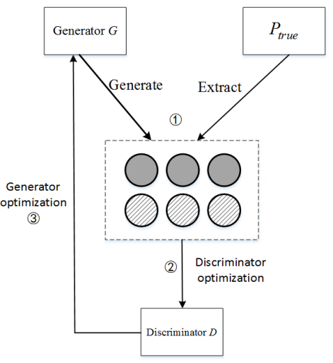
11
EmbedGAN Algorithm

Slide 13
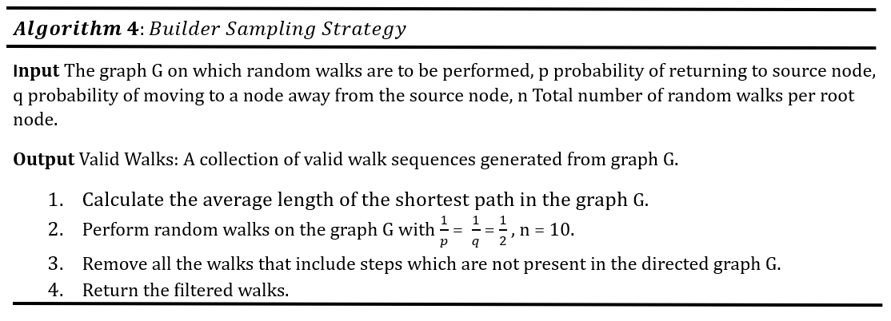
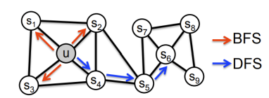
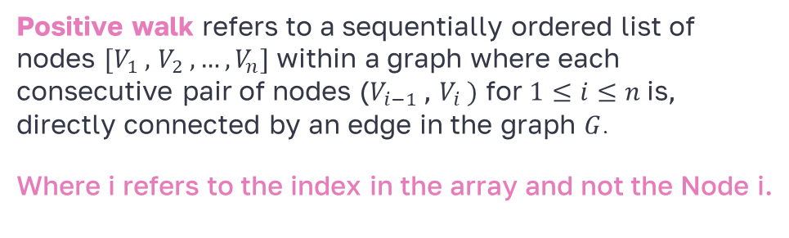
12
Positive Walks & Builder sampling strategy
q = Probability of BFS.
p = Probability of DFS.
Positive walk refers to a sequentially ordered list of nodes $[V_{1} ,$ $V_{2} ,…,V_{n}]$ within a graph where each consecutive pair of nodes ($V_{i−1}$, $V_{i} )$ for $1≤ⅈ≤n$is, directly connected by an edge in the graph $G$.
Where i refers to the index in the array and not the Node i.

Slide 14
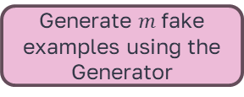
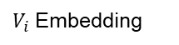
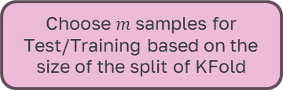
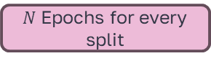
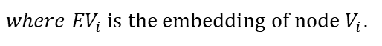
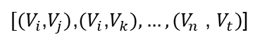
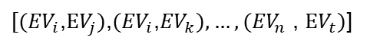
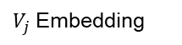
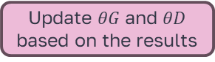
13
Training phase of the GAN model
256 - dimensional Vector
List of Valid Walks
Utilize KFold to split data into test / train
$V_{i}$ Embedding
$V_{j}$ Embedding
$[(V_{i}$,$V_{j})$,$(V_{i}$,$V_{k}),…,(V_{n}$ , $V_{t})$]
Tensor of concatenated embeddings
$N$ Epochs for every split
$[({EV}_{i}$,$EV_{j})$,$({EV}_{i}$,${EV}_{k}),…,({EV}_{n}$ , $EV_{t})$]
$where {EV}_{i} is the embedding of node{ V}_{i}$.
Choose $m$samples for Test/Training based on the size of the split of KFold
Update $θG$ and $θD$ based on the results
Train the Generator based on the Discriminator results
Train the Discriminator on real and fake examples
Generate $m$ fake examples using the Generator
Evaluate the model performance
Notes:
Select a predetermined percentage of the graph edges.
Concatenate node embeddings of the source and destination node for each edge.
Pass the embeddings to the discriminator which outputs a prediction score for each one.
Score is between 0 and 1, where scores closer to 1 suggest a higher relevance of the citation link.
These scores are then converted into binary predictions using a threshold (commonly 0.5).
Score > 0.5 means citation is relevant, otherwise it’s not relevant

Slide 15
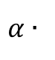
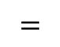
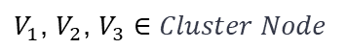
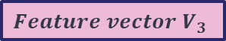
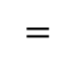
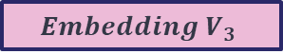


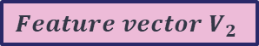
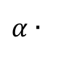
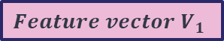
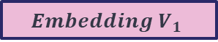
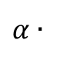


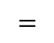
14
Assignment of Embeddings to Next Layer
$$V_{1}=\left[0,1,0,1,1…….,0\right]∈R^{1433}$$
$$α∈[0…1]$$
$$V_{1}\text{, }V_{2}\text{, }V_{3}∈Cluster Node$$
Cluster Node
$α$ ∙
$$Feature vector V_{1}$$
$$=$$
$$Embedding{ V}_{1}$$
$α$ ∙
$$Feature vector V_{2}$$
$$=$$
$$Embedding{ V}_{2}$$
Embedding of Cluster Node
$$Cluster Node∈G_{i}$$
$$V_{1}\text{, }V_{2}\text{, }V_{3}∈G_{i−1}$$
$α$ ∙
$$Feature vector V_{3}$$
$$=$$
$$Embedding{ V}_{3}$$
Feature vector ${ V}_{1}$ is the feature vector after the PCA modification.

Slide 16
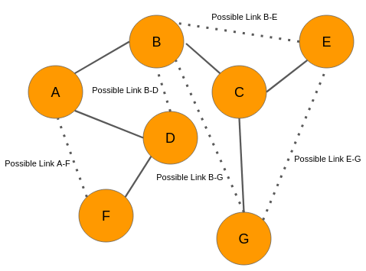
15
Link Prediction
Link Prediction refers to the task of predicting connections (links) between entities in a network.
In this project link predictions refers to predicting Citations between academic articles.
The importance of being able to accurately predict missing, future, bogus links in a network has opened a door for researchers to use graph modeling in many areas and advancing research in those topics by utilizing link prediction solutions.
Notes:
such as Social networks, Biological networks , Financial networks

Slide 17
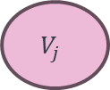
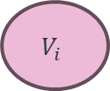
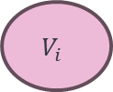
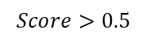
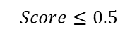
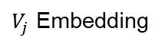


16
Final Link Predictions
256-dimensional Vector
Edge Embeddings
$V_{i}$ Embedding
$V_{j}$ Embedding
Discriminator
$$Score>0.5$$
$$Score≤0.5$$
$$V_{i}$$
Relevant
$$V_{j}$$
$$V_{i}$$
Irelevant
$$V_{j}$$
Notes:
Select a predetermined percentage of the graph edges.
Concatenate node embeddings of the source and destination node for each edge.
Pass the embeddings to the discriminator which outputs a prediction score for each one.
Score is between 0 and 1, where scores closer to 1 suggest a higher relevance of the citation link.
These scores are then converted into binary predictions using a threshold (commonly 0.5).
Score > 0.5 means citation is relevant, otherwise it’s not relevant

Slide 18
17
Results Classification and Examples
Relevant Citations: Success rate of 100%
High Likelihood of Relevant Citation: Success rates between 75% and 99%
Lower Likelihood of Relevant Citation: Success rates between 50% and 74%
High Likelihood of Irrelevant Citation: Success rate between 25% and 49%
Irrelevant Citation: Success rate below 25%
Notes:
Select a predetermined percentage of the graph edges.
Concatenate node embeddings of the source and destination node for each edge.
Pass the embeddings to the discriminator which outputs a prediction score for each one.
Score is between 0 and 1, where scores closer to 1 suggest a higher relevance of the citation link.
These scores are then converted into binary predictions using a threshold (commonly 0.5).
Score > 0.5 means citation is relevant, otherwise it’s not relevant

Slide 19


18
Results Histogram and Evaluation Metrics
Notes:
Select a predetermined percentage of the graph edges.
Concatenate node embeddings of the source and destination node for each edge.
Pass the embeddings to the discriminator which outputs a prediction score for each one.
Score is between 0 and 1, where scores closer to 1 suggest a higher relevance of the citation link.
These scores are then converted into binary predictions using a threshold (commonly 0.5).
Score > 0.5 means citation is relevant, otherwise it’s not relevant

Slide 20





19
Challenges - Graph Directionality in Citation Networks
Citation Networks graphs are directional graphs compared to social networks this means that we cannot use the ‘Edge Folding’ and ‘Vertex Merging’ as proposed in the original article.
Vertex Merging as suggest in the original article would not work in our case, since our graph is a directed graph that would mean in some cases of the vertex merging, we would reverse the citation direction leading to an incorrect representation of the citation within our graph.
$$1033$$
$$35$$
$$Biran$$
$$Ilya$$

Slide 21



20
Challenges
Discrepancies in Node Embeddings Across Graph Layers
$$V_{1}\text{, }V_{2}∈Cluster Node$$
Cluster Node
Graph | $G_{1}$ | $G_{2}$
Number of Nodes | $$N + K$$ | $$N$$
After applying Node2Vec on G2 we received $N$ embeddings.
Problem:
In the next iteration the number of nodes is $N+K$ but we only have $N$ embeddings from the previous layer.
Solution:
For each node in $G_{1}$, assign the embeddings of the cluster it belonged to in $G_{2}$ and add additional variation using its resized feature vector to achieve individuality between different nodes that belong to the same cluster.
Notes:
Select a predetermined percentage of the graph edges.
Concatenate node embeddings of the source and destination node for each edge.
Pass the embeddings to the discriminator which outputs a prediction score for each one.
Score is between 0 and 1, where scores closer to 1 suggest a higher relevance of the citation link.
These scores are then converted into binary predictions using a threshold (commonly 0.5).
Score > 0.5 means citation is relevant, otherwise it’s not relevant

Slide 22

21
Video
Notes:
Select a predetermined percentage of the graph edges.
Concatenate node embeddings of the source and destination node for each edge.
Pass the embeddings to the discriminator which outputs a prediction score for each one.
Score is between 0 and 1, where scores closer to 1 suggest a higher relevance of the citation link.
These scores are then converted into binary predictions using a threshold (commonly 0.5).
Score > 0.5 means citation is relevant, otherwise it’s not relevant

Slide 23
Thanks!
Any questions?

